Slide 1

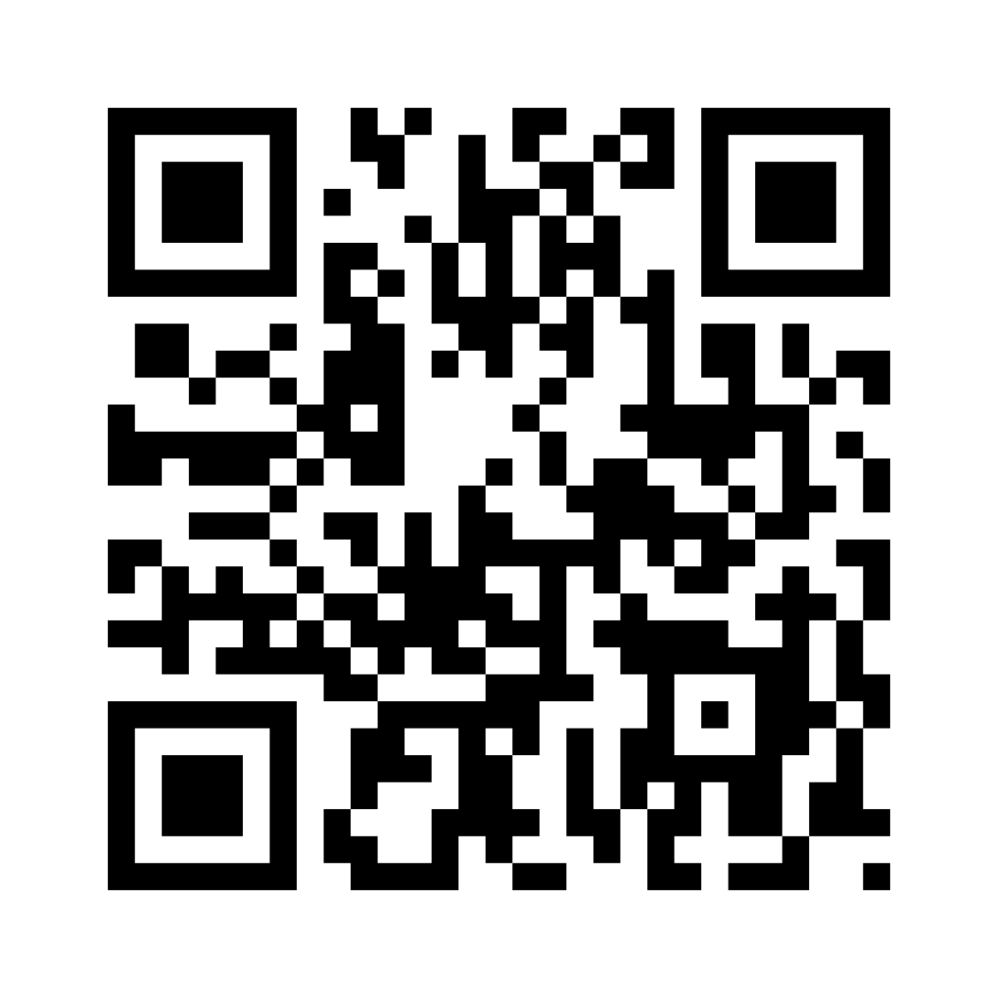

Malicious URL Detection
Final Project
Ya'eer Kidron
Yair Toledano
Yulia Ryvkin

Slide 2

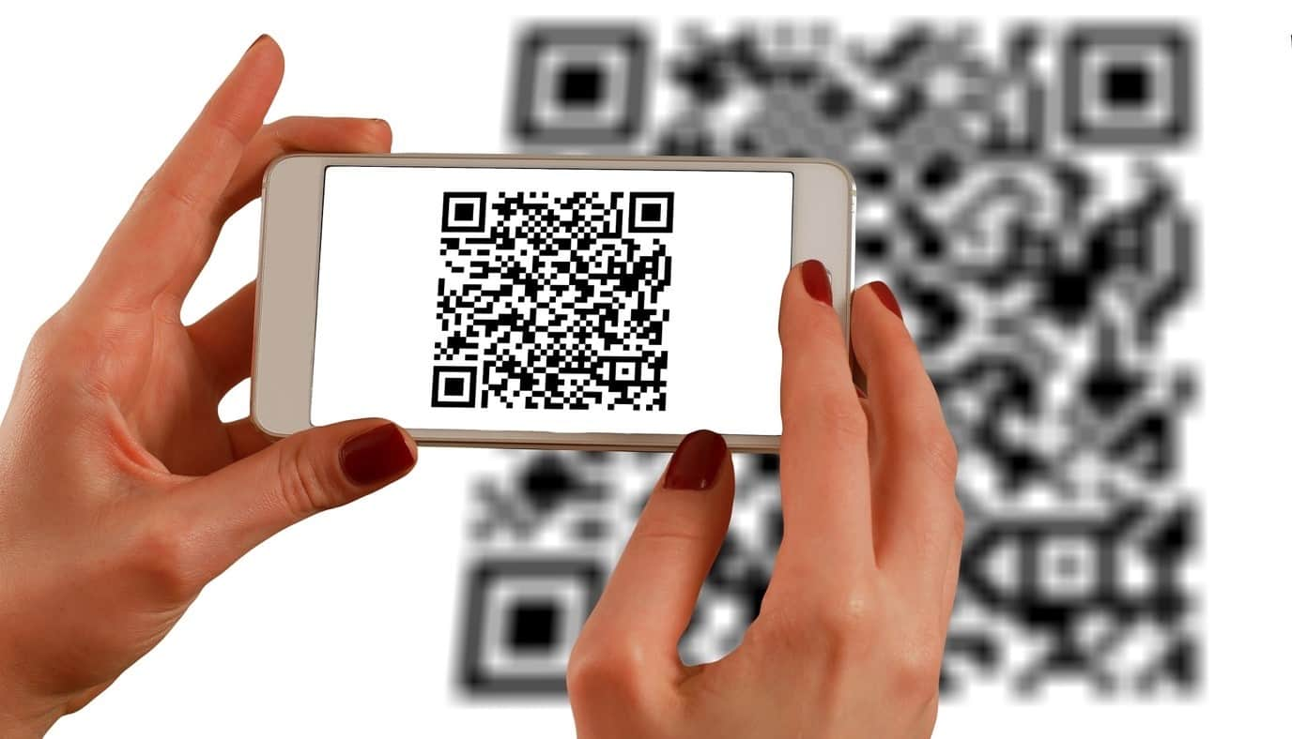
Background
Malicious websites are used by perpetrators to control victims’ machines or get their data remotely, and they are a known threat.
It is difficult and nearly impossible to identify the threat just by looking at the URL, or even more so, when the link to the website is encoded by a QR code.
In an attempt to find a solution to this problem, this work aims to detect malicious links by way of classifying URL strings and by analyzing URLs embedded in 2D (QR) codes.

Slide 3
List of URLs
Feature extraction
QR code
Neural Nets
Classical Models
Neural Nets
Classical Models

Slide 4
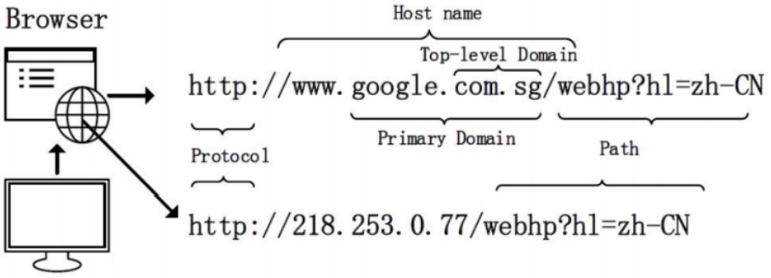
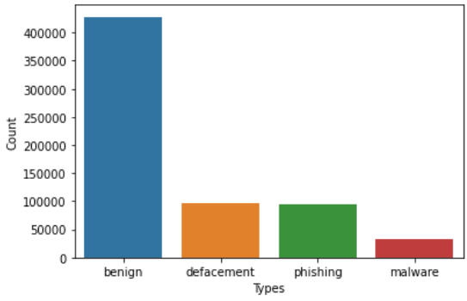
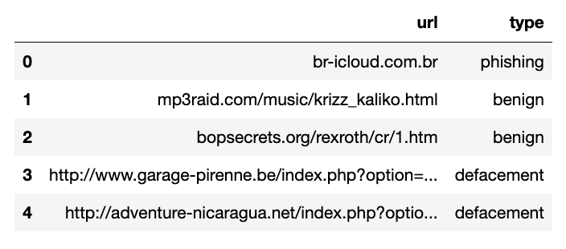
EDA
URL Detection - Overview
https://www.kaggle.com/datasets/sid321axn/malicious-urls-dataset

Slide 5
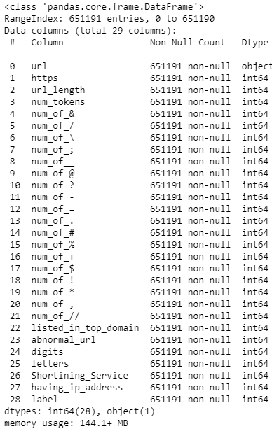
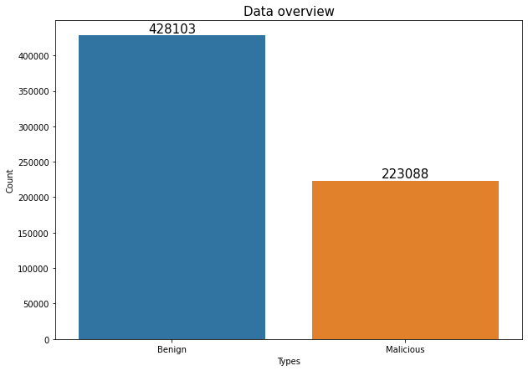
EDA
URL Detection - Overview

Slide 6
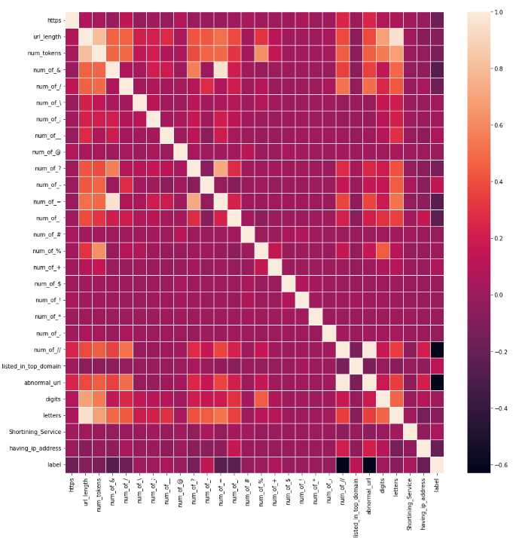
EDA
URL Detection - Feature Extraction
Contain_https
Url_length
Num_tokens
Num_symbol ('&','/','\\',';','_','@','?','-','=','.','#','%','+','$','!','*',',','//')
Listed_in_top_domain
Abnormal_url
Digit_count
Letter_count
Shortening_Service
Having_ip_address
Strong Correlation: “num_of_=“ Vs “number of &”, ”letters” Vs “url_length”
Strong Inverse Correlation: Label Vs Number of “//” and abnormal url

Slide 7
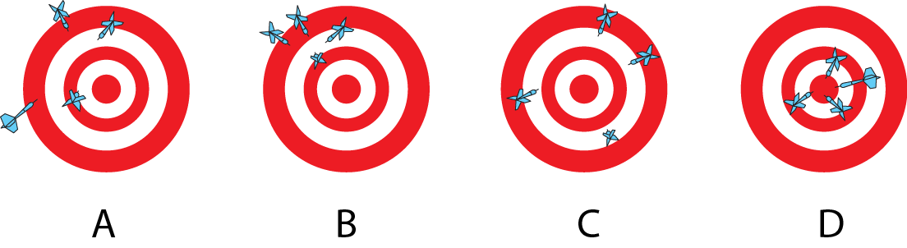
EDA
URL Detection - Scoring Method
As our project is more literary research-oriented, we decided to choose the Accuracy metric.
However, from a business perspective we should consider the following issues:
It is a big risk to refer a user to a “Malicious” site that was wrongly predicted as “Benign” (False-Negative).
Counting on the Precision score alone could lead to classifying all sites as “Malicious”.
Thus, the “F1” method should have been the right score for future implementation. However, trying to optimize this metric yields in a 50% accuracy.

Slide 8
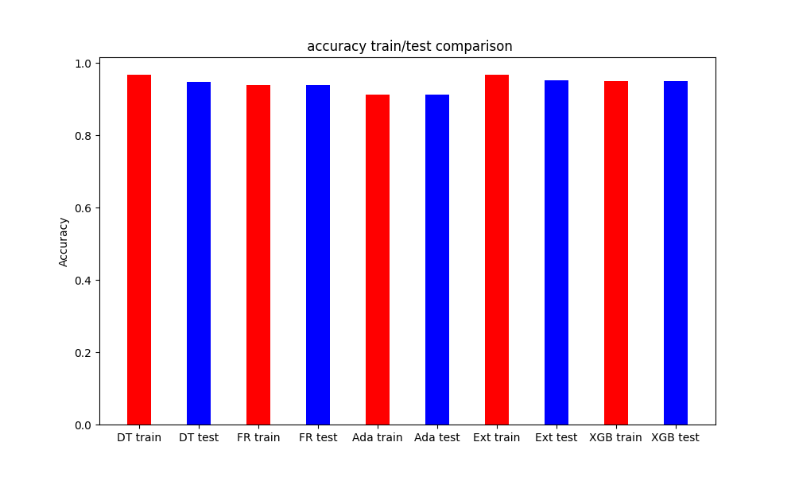
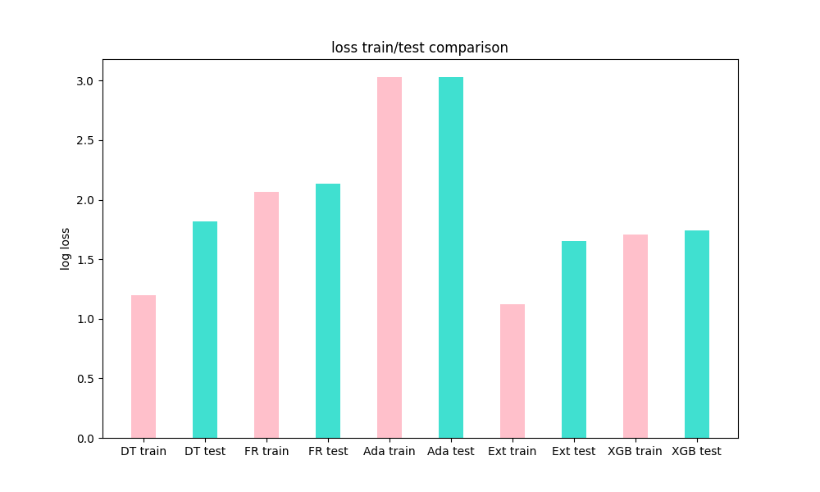
Classical Models
URL Detection - Classical Models
DT = Decision tree
RF = Random Forest
Ada = Adaboost
Ext = Extra Tree
XGB = XGBoost
Balancing the data didn’t improve the score
Cross validation was applied to the models
Extra Tree model - received the best accuracy and the lower loss
Notes:
accuracy
DTacc = [0.967, 0.947]
FRacc = [0.94, 0.938]
Adaacc = [0.9122, 0.9123]
Extacc = [0.9675, 0.952]
XGBacc = [0.95, 0.949]

Slide 9
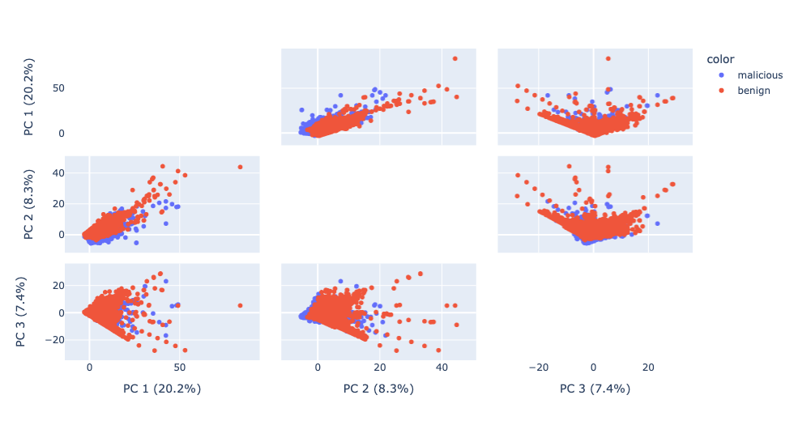
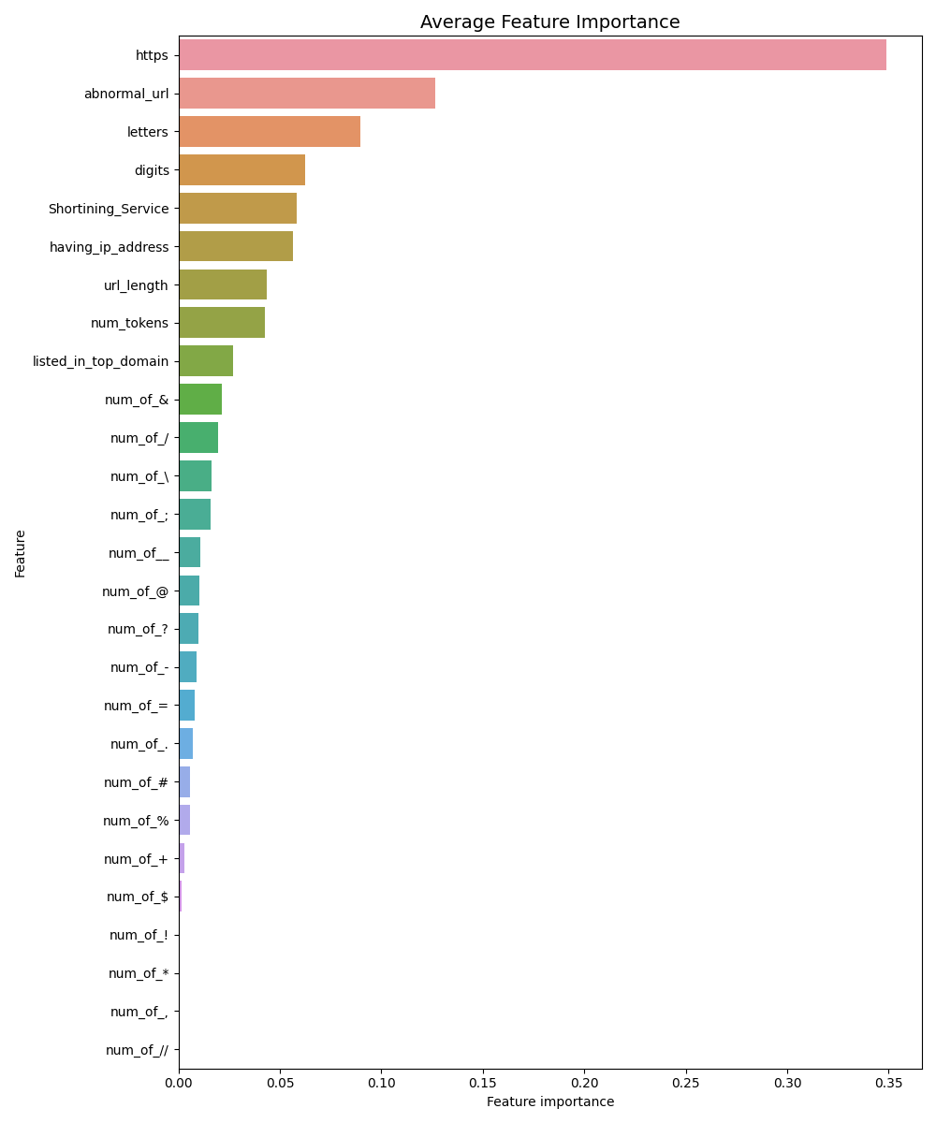
Classical Models
URL Detection - Feature importance
PCA shows that the three principal components explain only a small portion of the variance, and thus it is better to use all the features for classification
Average feature importance highlighted a few interesting features: having https, number of letters and digits, and containing a shortening service

Slide 10
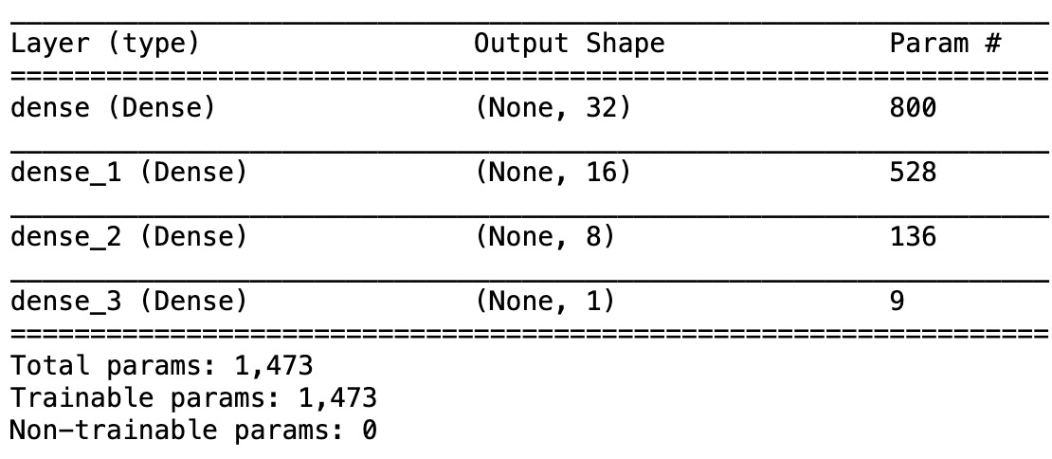
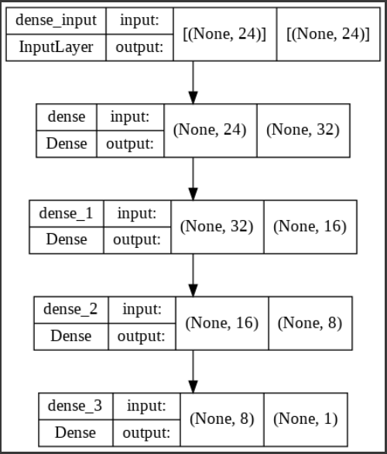
Neural Nets
URL Detection - NN Binary classification
Layers: 3
Functions: Relu, Sigmoid

Slide 11
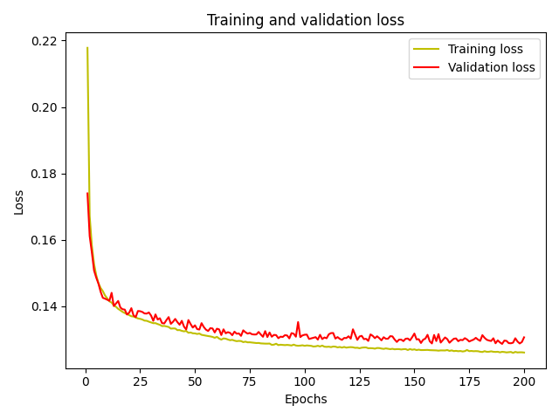
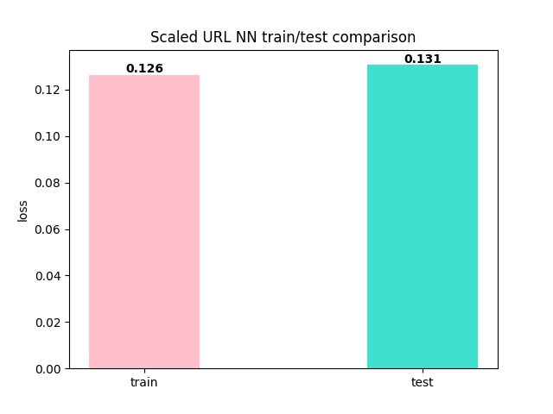
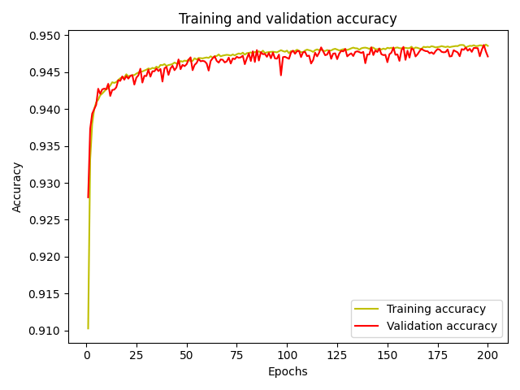
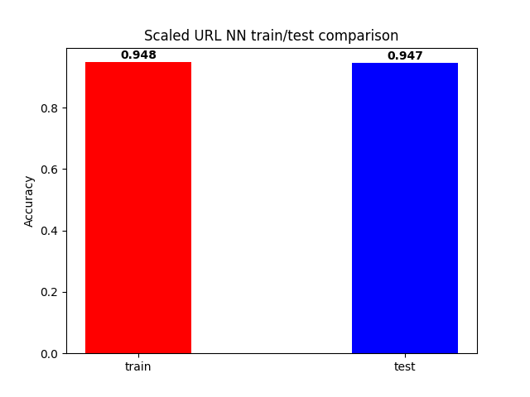
Neural Nets
URL Detection - NN Binary classification

Slide 12
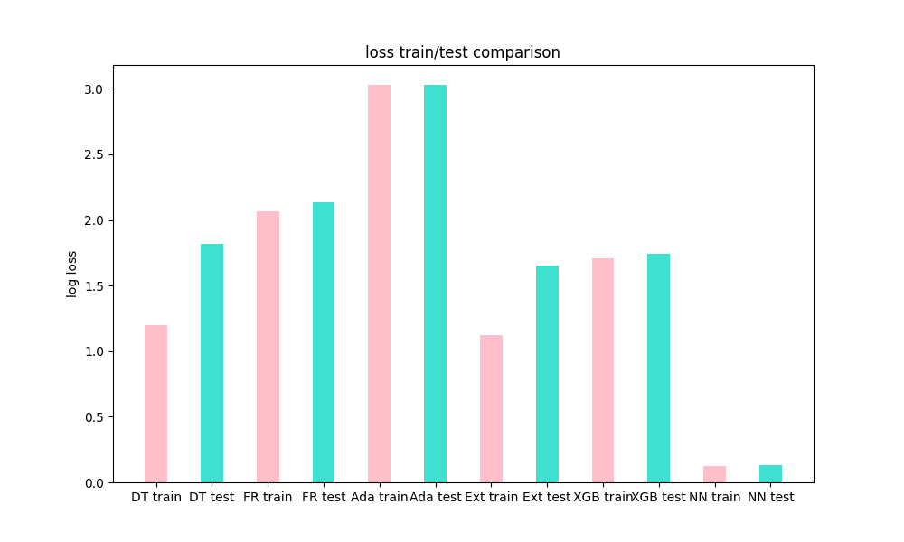
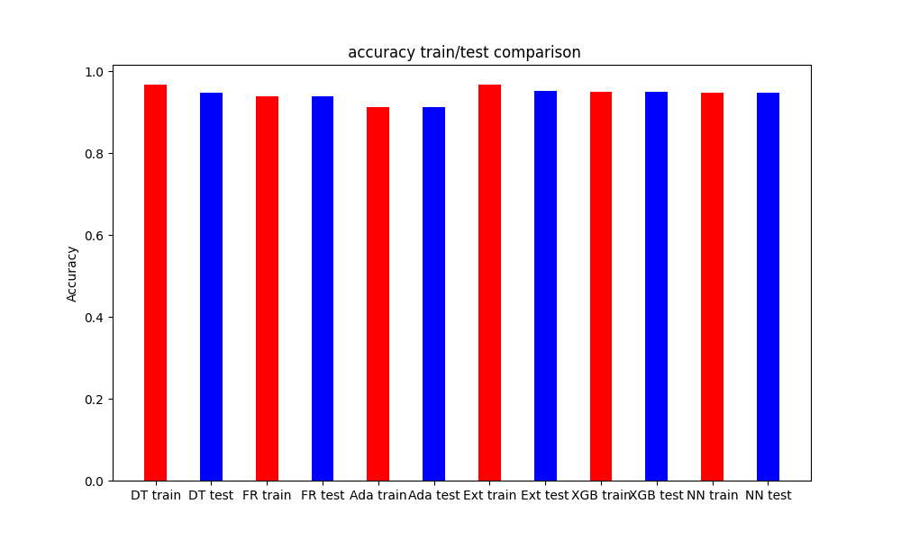
Neural Nets\Classical
URL Detection - Models Comparaments
DT = Decision tree
RF = Random Forest
Ada = Adaboost
Ext = Extra Tree
XGB = XGBoos
NN = Neural-Network
Extra Tree model - gave the highest accuracy score
NN model - received the lowest loss score, but didn’t improve the accuracy
Notes:
accuracy
DTacc = [0.967, 0.947]
FRacc = [0.94, 0.938]
Adaacc = [0.9122, 0.9123]
Extacc = [0.9675, 0.952]
XGBacc = [0.95, 0.949]
NNbinary =[0.948, 0.947]
Log loss
DTlog = [1.2, 1.82]
FRlog = [2.066, 2.132]
Adalog = [3.03, 3.028]
Extlog = [1.12, 1.65]
XGBlog = [1.709, 1.74]
NNbinarylog =[0.126, 0.131]

Slide 13
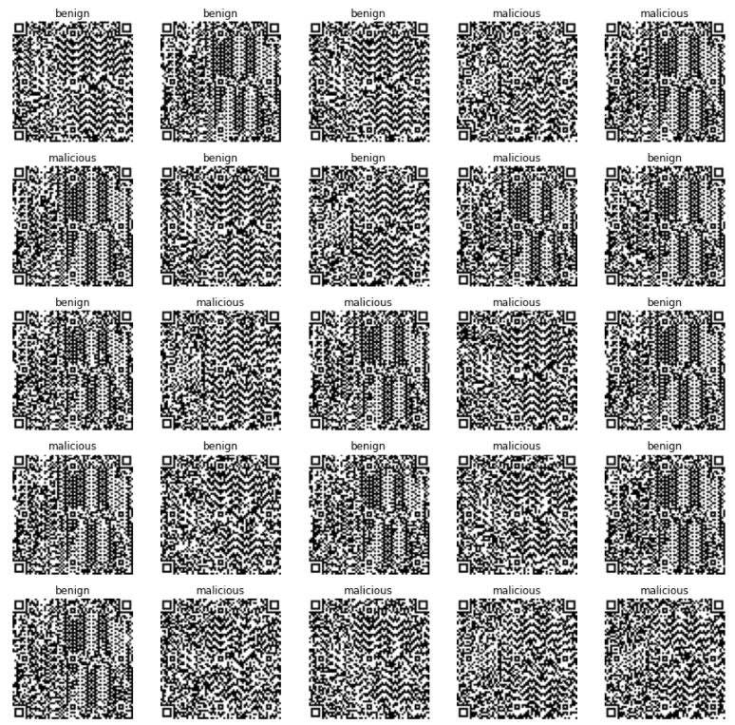
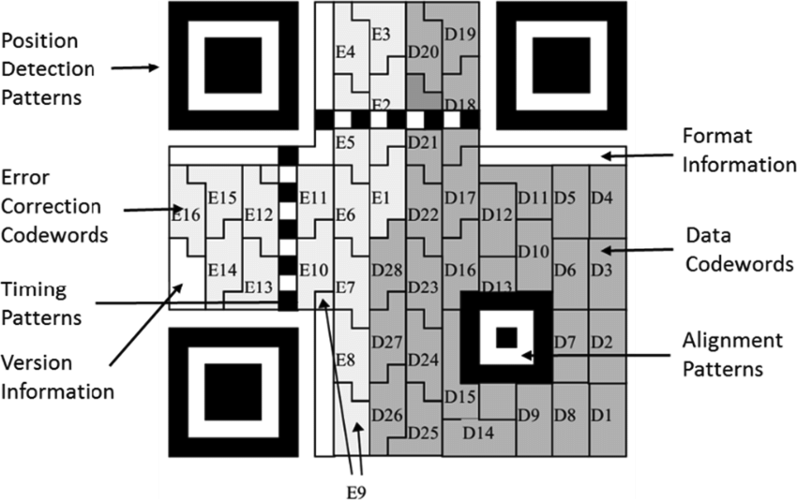
QR Code
QR code Classification
URLs were converted to Version 12 QR codes
QR code is a black/white image, non injective
Version 12 is 65x65
For the binary classification we used: 90K QRs having the benign label, and 30K from each malicious label subgroup

Slide 14
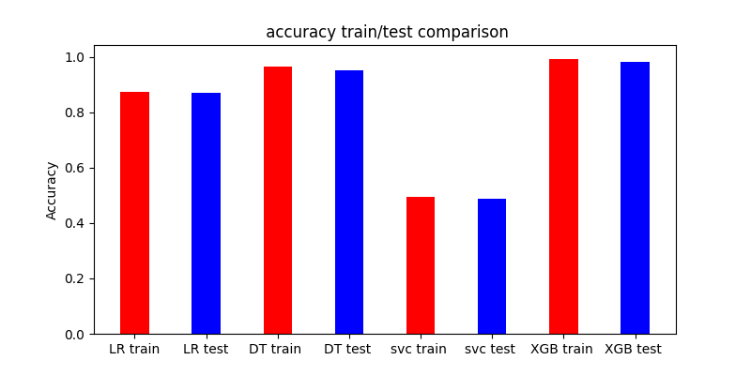
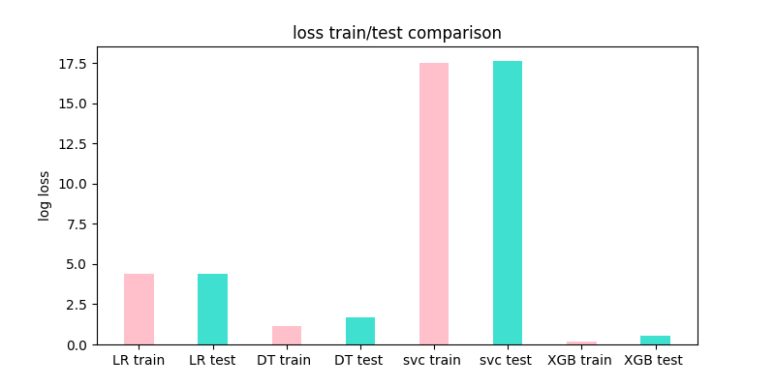
Classical Models
QR code Classification using Classical Models
Total number of components: 4225
LR = Logistic Regression. 200 PCA components
DT = Decision tree. All components
SVC = SVM. 400 PCA components
XGB= XGBoost
XGBoost yielded higher accuracy and lower log-loss compared to the other classical models
Notes:
Accuracy scores:
LRacc = [0.873, 0.8722]
DTacc = [0.966, 0.9509]
SVCacc = [0.4935, 0.48922]
XGBoostacc = [0.9939, 0.9835]

Slide 15
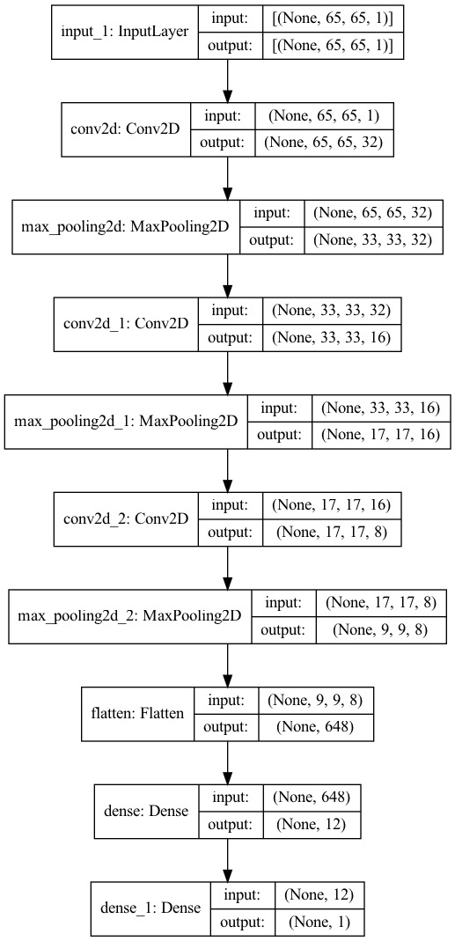
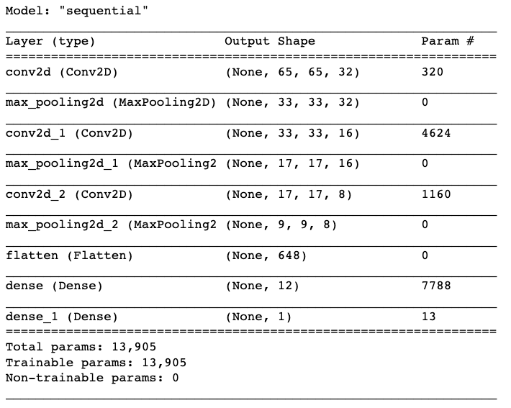
Neural Nets
Binary classifier NN

Slide 16
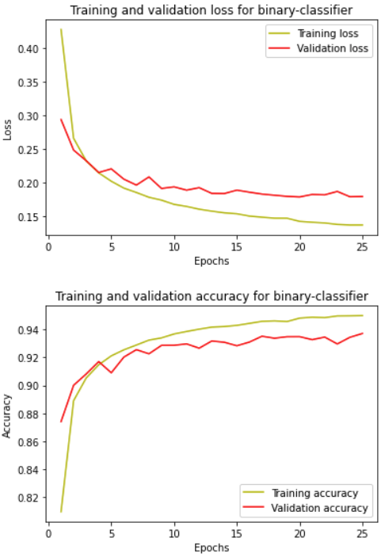
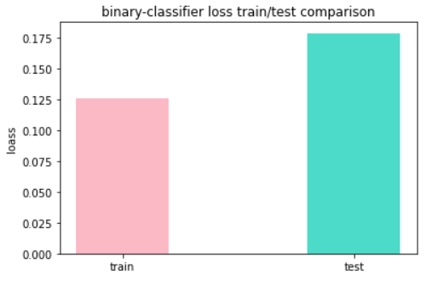
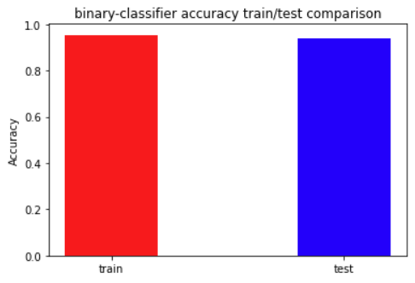
Neural Nets
Binary classifier NN

Slide 17
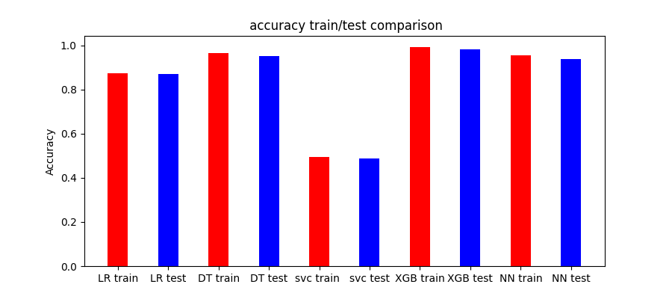
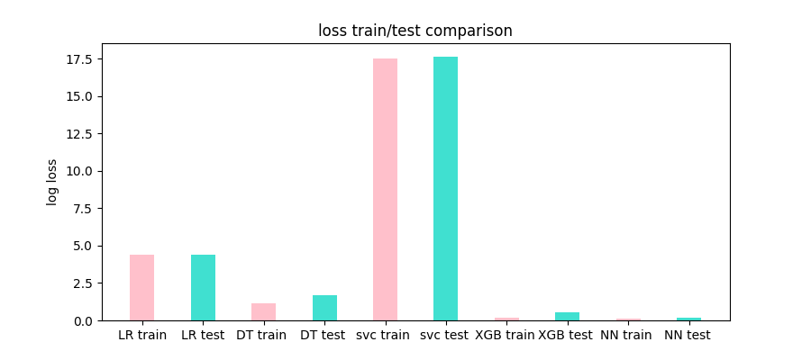
Neural Nets
A comparison between the classical models and binary neural networks
LR = Logistic Regression
DT = Decision tree.
SVC = SVM
XGB = XGBoost
NN = neural network
The XGBoost model yielded higher accuracy compared to the simple binary NN model
Notes:
Accuracy scores:
LRacc = [0.873, 0.8722]
DTacc = [0.966, 0.9509]
SVCacc = [0.4935, 0.48922]
XGBoostacc = [0.9939, 0.9835]
NNbinary =[0.9544, 0.9370]

Slide 18
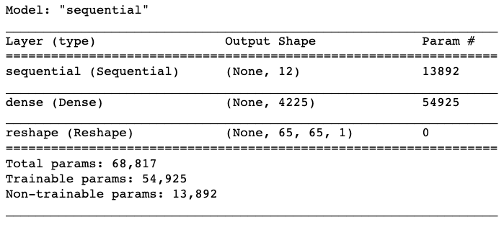
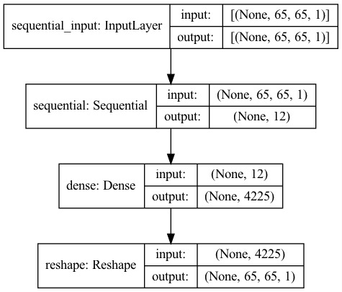
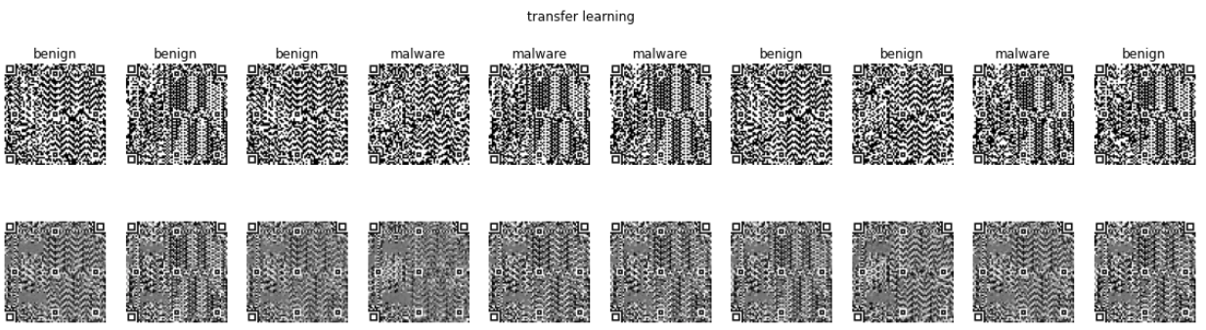
Neural Nets
Transfer learning

Slide 19
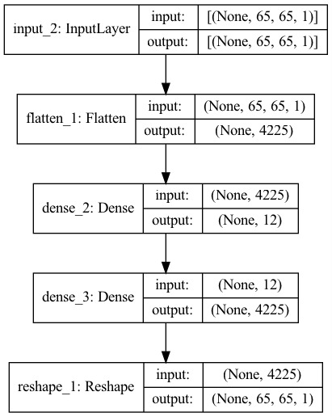
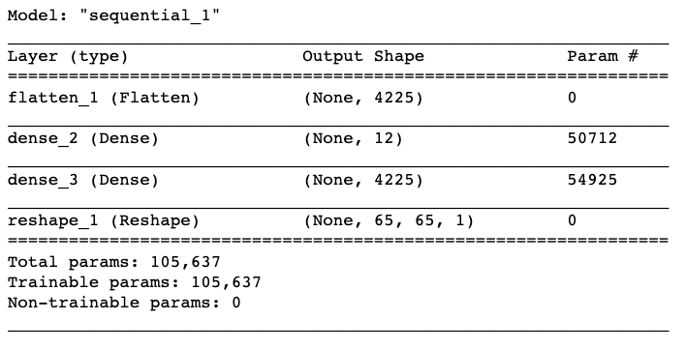
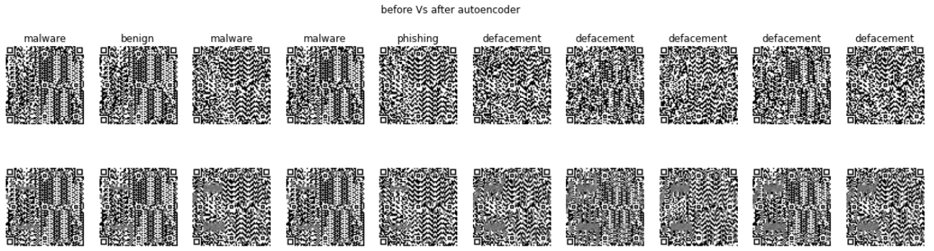
Neural Nets
Autoencoder

Slide 20
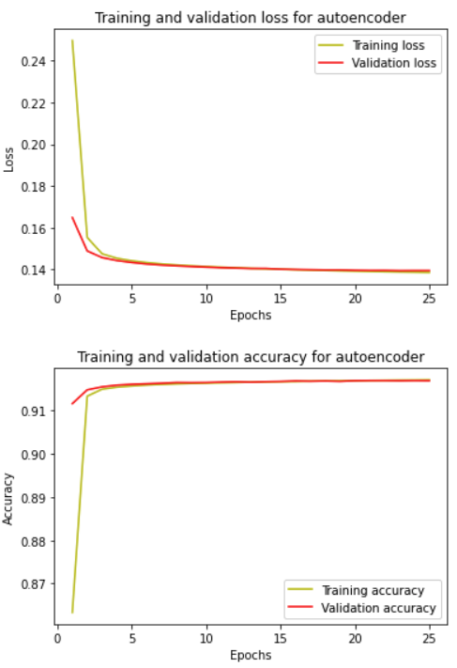
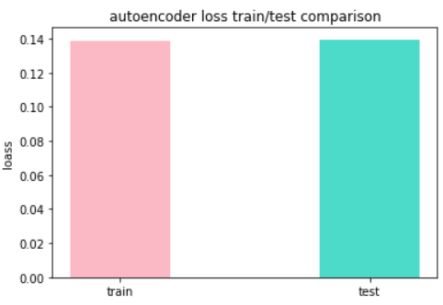
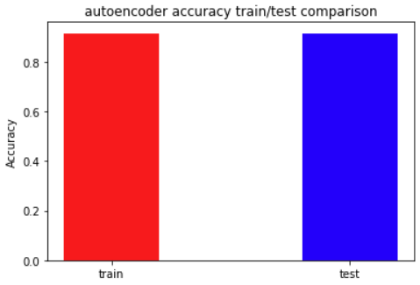

Slide 21
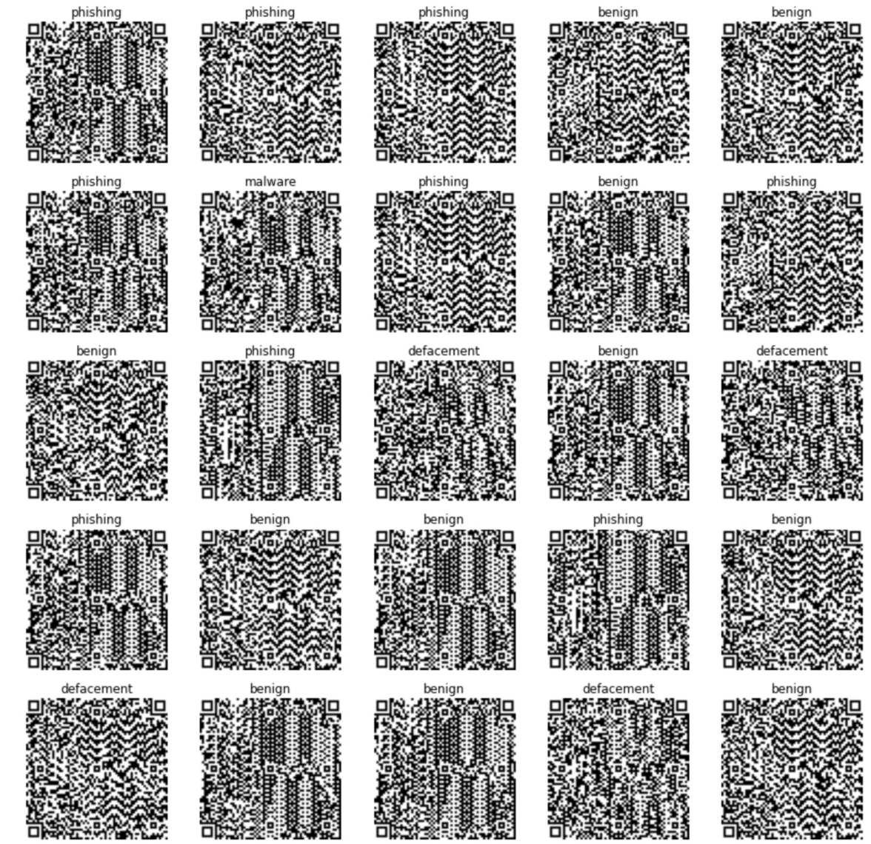
Neural Nets
Multiclass classification NN
For the Multi classifier we took: 30K QRs from each label: benign, malicious, defacement, and phishing

Slide 22

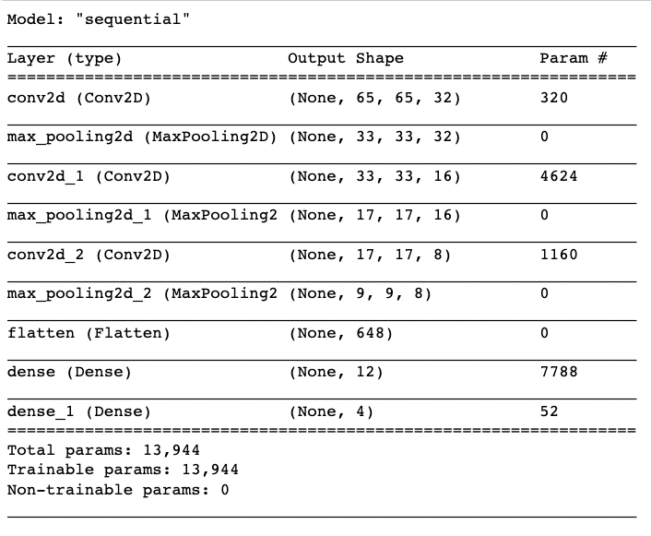
Neural Nets
Multiclass classification NN

Slide 23
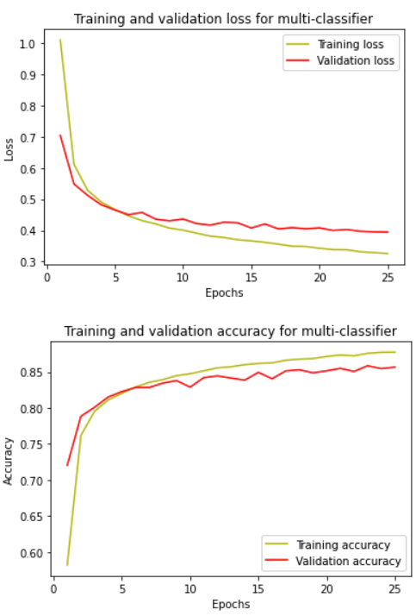
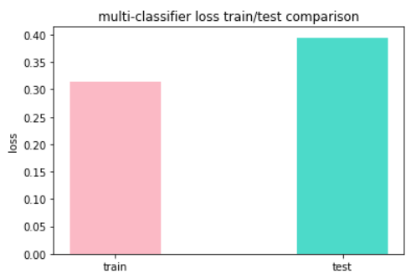
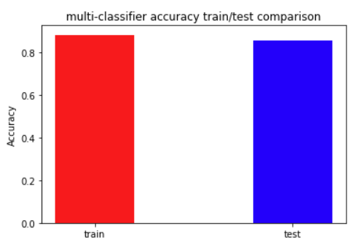
Neural Nets
Multiclass classification NN

Slide 24
URL\QR
URL\QR Detection - Models Comparaments
URL
QR code
Neural Nets
Accuracy = 94%
Classical Models
Accuracy = 95%
Neural Nets Accuracy = 95%
Classical Models
Accuracy = 99%
Business conclusion:
In case there is a need for a fast response —> URL Detection using Extra tree classifier
In case there is a need for the highest accuracy —> QR Detection using XGBoost classifier

Slide 25
Insights
Classical models were as successful as NN in classifying URLs
When modeling the URLs, one has to have insights into the feature extraction
The binary classification of QR codes was of higher accuracy than the multiclass classification when performed using neural networks
Together, these results suggest that there is a profound difference between malicious and benign URLs, which can be detected and used to avoid entering malicious sites.

Slide 26
Next steps
Determine which combination of the URL elements is the best indicator for malicious sites.
Combine the URL and the QR models to hopefully get a better result.
Run TF-IDF to quantify the importance or relevance of sub-string representations.
Classify and identify other types of sites which can be considered harmful, like websites that spread fake news.
Develop a QR scan application, which traps the malicious threats before opening the links

Slide 27
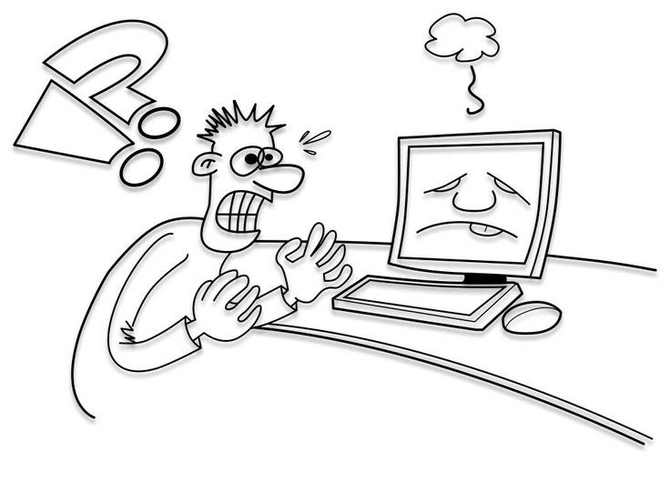
Thanks For Listening!

Slide 28
“Who are you then?" "I am part of that power which eternally wills evil and eternally works good.”
― Johann Wolfgang von Goethe,Faust

